Slide 1

ITM - 891
Project Presentation
TEAM
Prudhvi, Rahul, Vivek & Sharan

Slide 2
Overview of data
Data source: University of California Irvine Machine Learning Repository http://archive.ics.uci.edu/ml/datasets/Online+Shoppers+Purchasing+Intention+Dataset#
Numerical Variables | Type | Description
 | Administrative | represent the number of different types of pages visited by the visitor in that session
 | Administrative_Duration | total time spent in each of these page categories
 | Informational | represent the number of different types of pages visited by the visitor in that session
 | Informational Duration | total time spent in each of these page categories
 | Product Related | represent the number of different types of pages visited by the visitor in that session
 | Product Related Duration | total time spent in each of these page categories
 | Bounce Rate | The value of "Bounce Rate" feature for a web page refers to the percentage of visitors who enter the site from that page and then leave ("bounce") without triggering any other requests to the analytics server during that session.
 | Exit Rate | The value of "Exit Rate" feature for a specific web page is calculated as for all pageviews to the page, the percentage that were the last in the session.
 | Page Value | The "Page Value" feature represents the average value for a web page that a user visited before completing an e-commerce transaction.
 | Special Day | The "Special Day" feature indicates the closeness of the site visiting time to a specific special day (e.g. Mother’s Day, Valentine's Day) in which the sessions are more likely to be finalized with transaction.
Categorical Variables | operating system | Operating system used by the user
 | browser | Browser used by user
 | region | Region of user
 | traffic type | traffic type representing the page which had referred the user to the bookstore site
 | visitor type | visitor type as returning or new visitor
 | weekend | a Boolean value indicating whether the date of the visit is weekend
 | month | month of the year
 | Revenue | Binary of whether the transaction has happened or not

Slide 3
What are we trying to solve?
What data do we have ? What are we doing ?
We have customer level information of their online sessions
Predicting customer purchase decision from online session behaviour

Slide 4
Trends & Insights

Slide 5
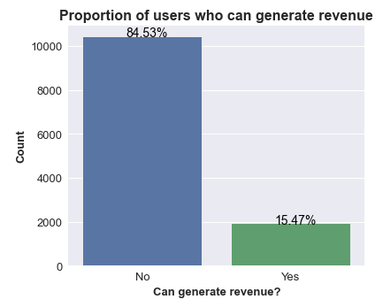
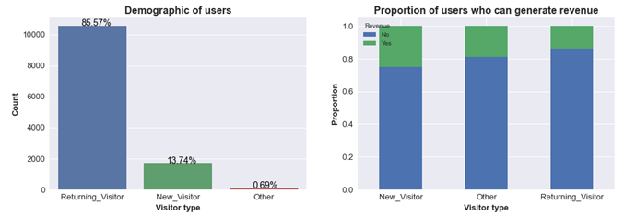
Summary of online visitors
Comments:
Only 15.5% of the visitors are buying products online and generating revenue.
Almost 85% of the users have visited more than once in the past, and 14% of the users are visiting for the first time.
Proportion of sessions that end up generating revenue is highest in user group visiting for the first time. Maybe users get promotional offers while shopping for the first time.

Slide 6
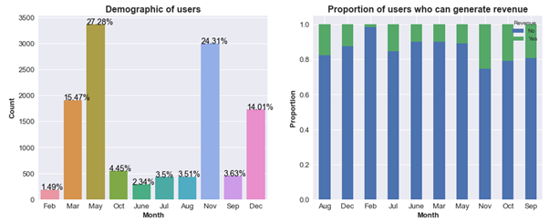
Which are prospective months?
Comments:
November month has almost 25% of total user activity and has highest proportion of sessions generating revenue. Maybe it’s Black Friday sale.
August, September, October months seem to be prospective with lower activity rates but, higher proportion of sessions generating revenue.
February is dullest month with least amount of activity and least proportion sessions generating revenue.

Slide 7
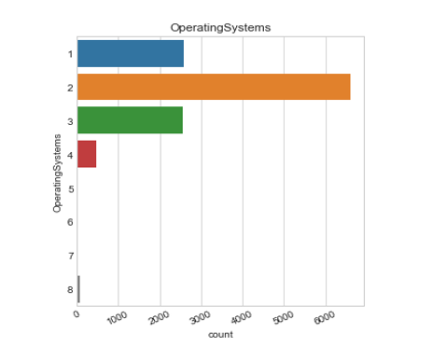
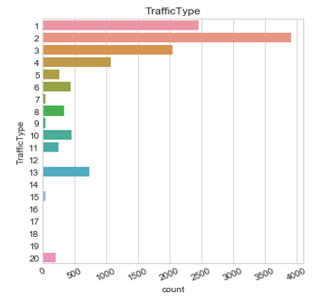
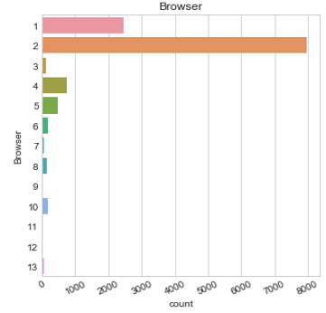
Technology preference
Traffic type (referral page type) Operating System type Browser type
Comments:
As we can clearly see here browsers 1 & 2 contribute the maximum to the traffic. Also traffic type has certain pages with referral links which have high numbers of users.

Slide 8
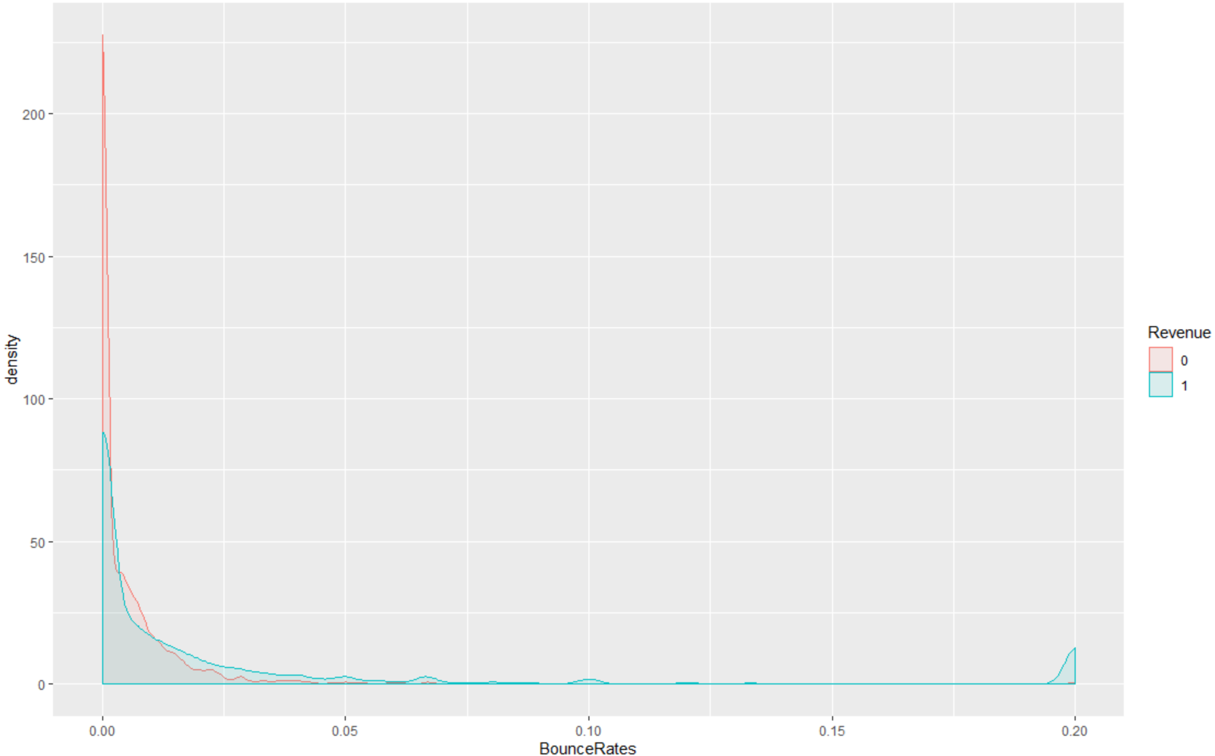
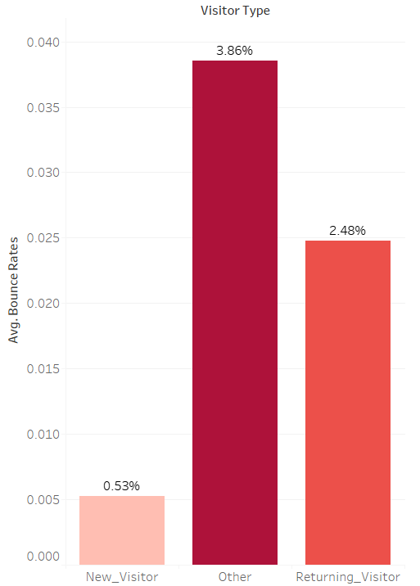
Bounce Rate - Trends
Comments:
The Average overall Bounce Rate for New_Visitor seems to be the least among the New Audience

Slide 9
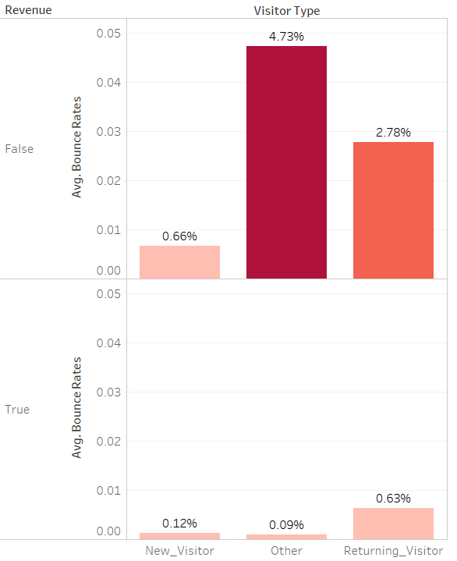
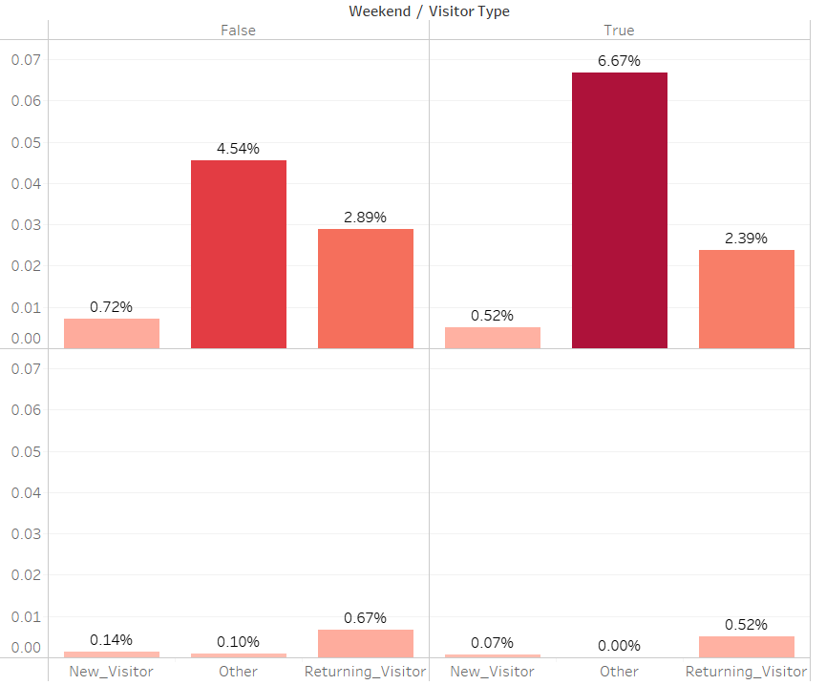
Bounce Rate Trends
Overall - Bounce Rate Trend
Split of Bounce rate Trend
Comments:
- The data suggests that New users are more interested in the site
- From a Revenue standpoint, We can see that the Avg. Bounce rate is less for the users who contribute to the Revenue
- New Visitors during the weekend have the least bounce rate - Highly engaged
Note: Others are almost negligible for this analysis(count wise)but included them since the Bounce rate is highest among the 3 groups

Slide 10
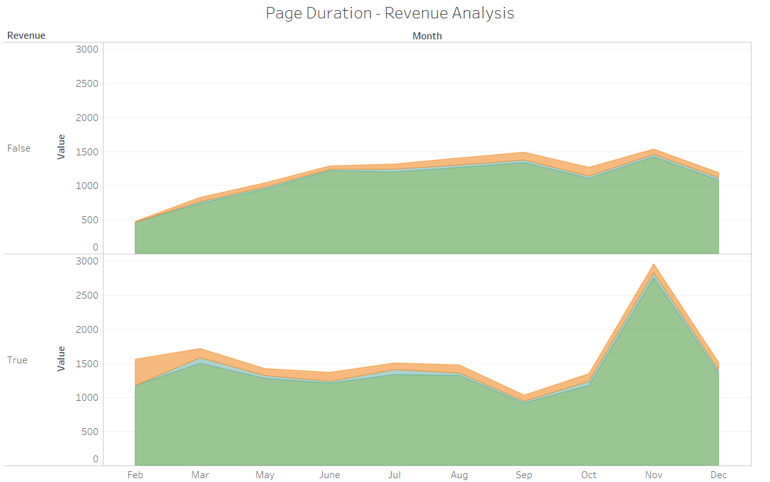

Monthly Web Page Duration - Trends
Comments:
The clear change in Revenue in November can be seasonal - Black Friday Sale.
We can see the relative trend of average time spent in each section of the website here
The time spent in product section has peaked in November and contribute to major traffic
The administrative section had relatively more traffic in the initial months of Feb. and March

Slide 11
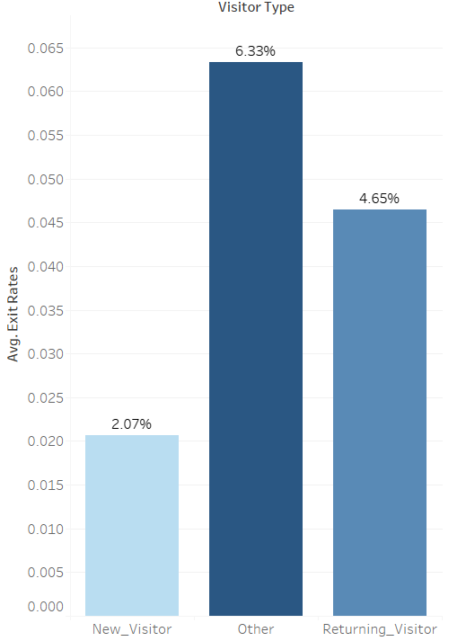
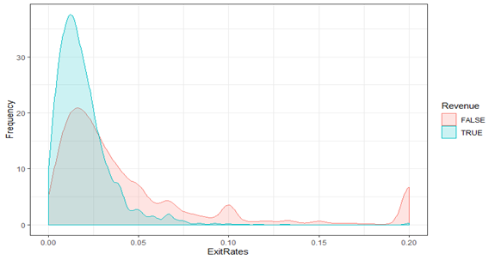
Exit Rate - Trends
The value of "Exit Rate" feature for a specific web page is calculated as for all pageviews to the page, the percentage that were the last in the session.
Comments:
We can see that a returning user has more exit rates than a new user since they already know the page well so they are spending less time taking action they need to take
Also one thing to observe is that exit rates are skewed towards right for both the types of transactions

Slide 12
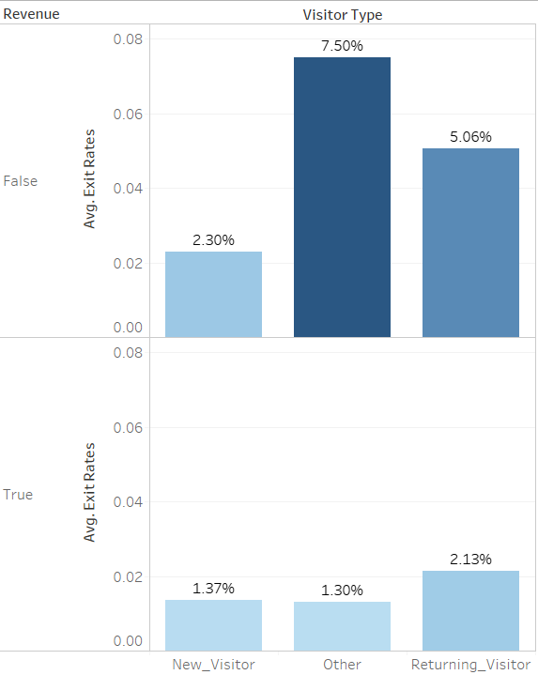
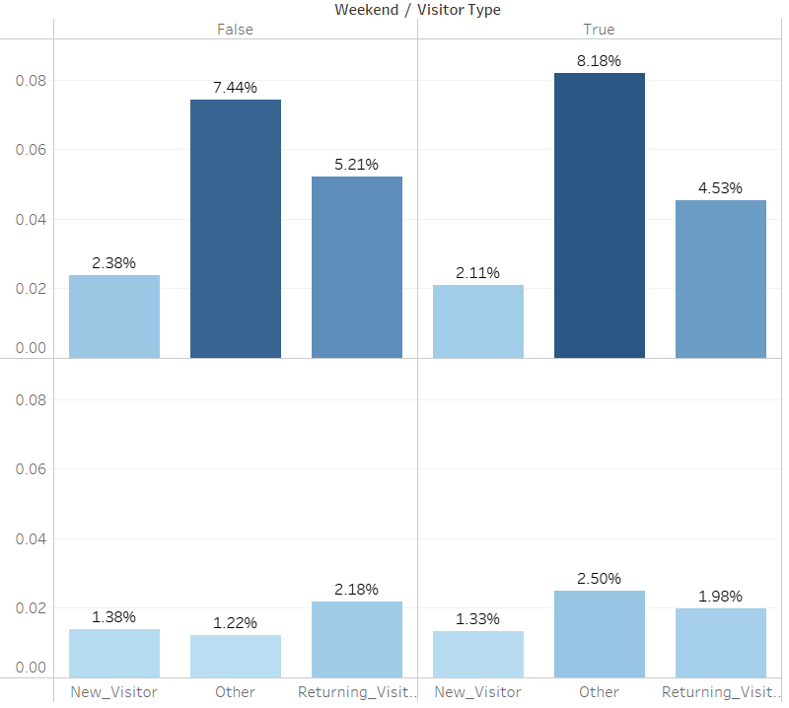
Exit Rate Trends
Overall - Exit Rate Trend
Split of Bounce rate Trend
Comments:
- Similar to the bounce rate, Exit rate is the least in the New Visitors contributing for the Revenue
- We need to check if Bounce rate and Exit rate are linked with each other(Correlation) - To be explored in the future slides

Slide 13
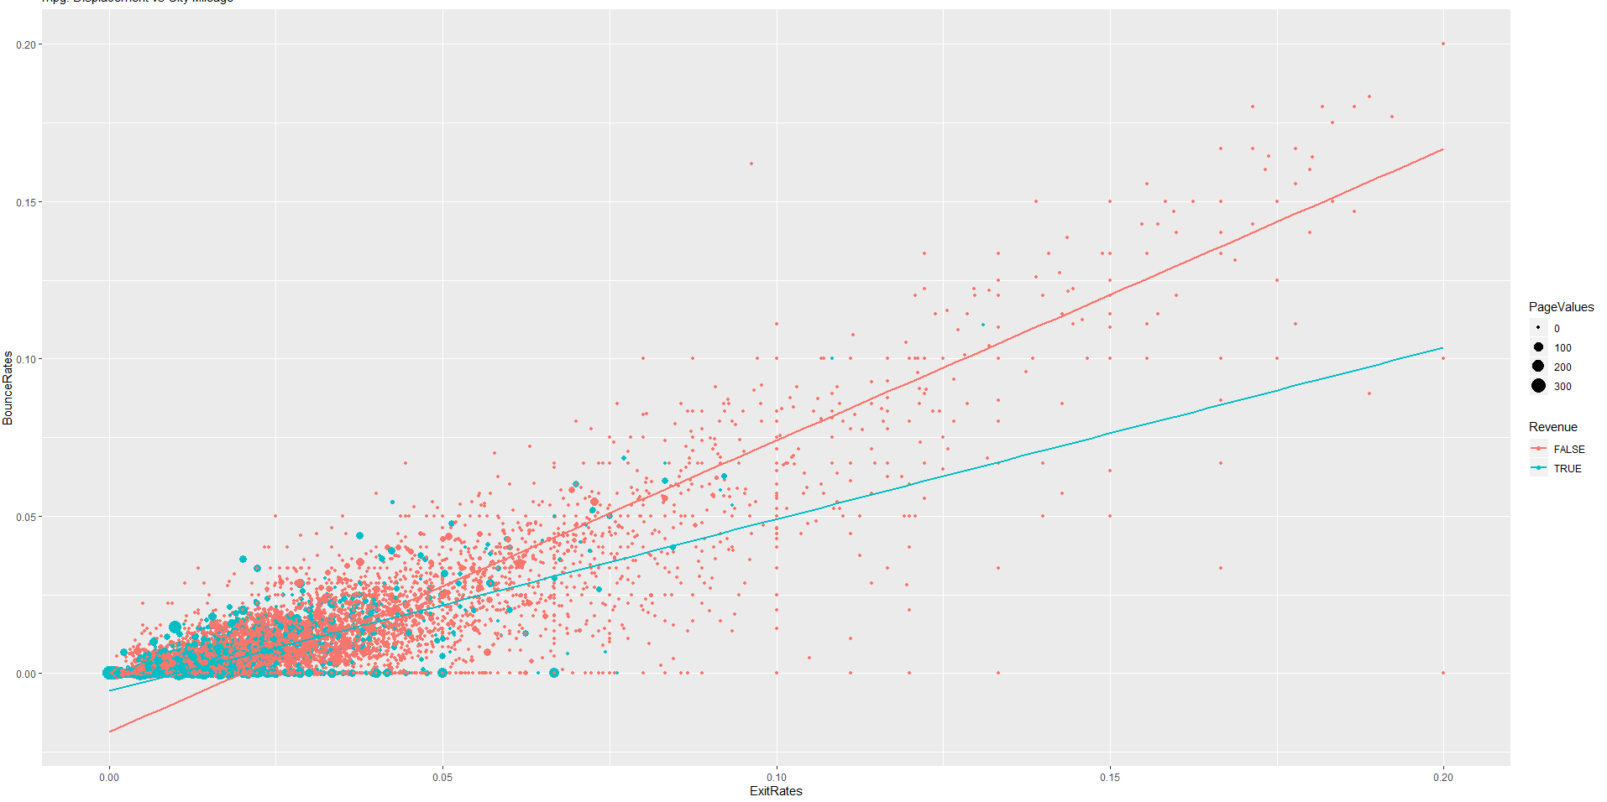
Exit rate vs Bounce rate
Comments:
We can see the average time spent in each section here
We can see that the trendlines for sessions when transaction doesn’t happen has a higher slope than Revenue =True indicating that BounceRate is relatively high in comparison to ExitRates, ExitRates are relatively high in comparison to BounceRates for sessions where transactions happen

Slide 14
Statistical Analysis and Modelling

Slide 15
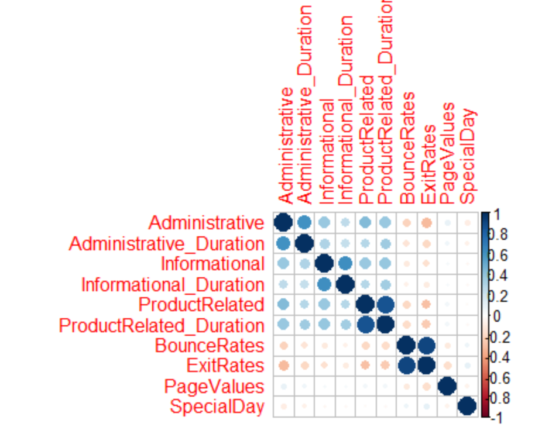
Correlation among numerical variables
Comments:
As we can see here the correlation between numerical variables like Administrative and Administrative_Duration is very high,around 0.6.It is similar for other duration types.
The same can be said for BounceRates and ExitRates
These need to be taken care of to improve the accuracy of the model

Slide 16
Modelling
Problem Type: Classification since the Outcome variable has 2 outcomes
Models Implemented
Logistic Regression
Logit + Lasso Regression
Decision Tree Classifier

Slide 17
Models Summary
Model | Features | Accuracy | ROC AUC
Base Logit Model | 27 | 0.89 | 0.68
Logit with Lasso | 3 | 0.89 | 0.68
Optimized Logit | 3 | 0.9 | 0.77
Decision Tree | 4 | 0.9 | 0.78
Comments:
Base logit model with default hyperparameters and all features yielded accuracy of 0.89.
Logit model with Lasso regression had significantly reduced the input features down to 3, yielding the same prediction accuracy.
Further, optimizing the model by setting the threshold value to 0.275 had improved the prediction accuracy and ROC AUC value significantly.
Decision Tree Classifier with four features gave the highest accuracy of 0.904. Classification error is 0.0940

Slide 18
Interpretation of Logit Model
Variable | Coefficient | p-value | Odds | p% | Interpretation
ExitRate | -20.647091 | very small | 0.000000001 | 0.999999999 | for every 1% (0.01) increase in exit rate, odds of customer making purchase reduces by 18.65%
PageValues | 0.081613 | very small | 1.09 | 8.5 | every unit increase in pagevalue, the odds of getting revenue from customer increases 8.5%
Month_Nov | 1.061094 | very small | 2.89 |  | The odds of customer making a purchase is 2.89 times more in the month of November than in August(base month), when other factors are taken into account
Comments:
As we can clearly see that the PageValues variable is a high value attribute which is predicting the transaction probability.
if page value is lower than 0.94 then transaction is happening and for higher than 0.94 there is a split at PageValue=19
If the PageValue is betweem 0.94 and 19 and it is November,BounceRate is less than 0.0073 then transaction doesn’t take place
If PageValue is greater than 19 then transaction is not done by the customer.

Slide 19
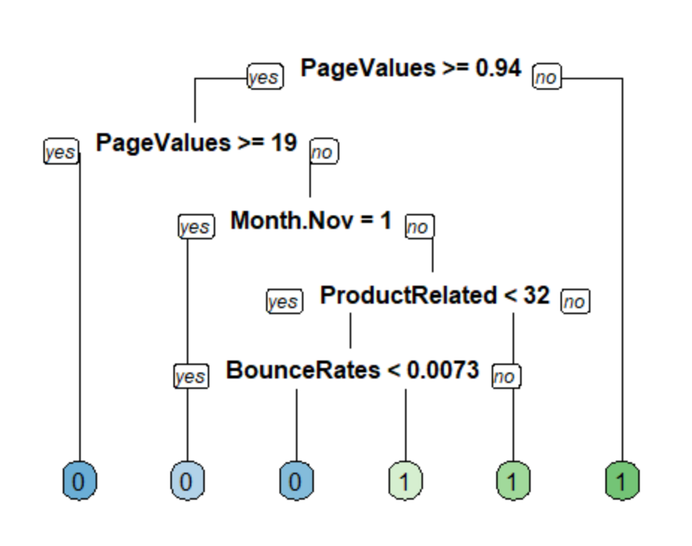
Decision Tree - Feature Importance
Model Accuracy:
We observed that the decision tree model accuracy is 90.3% when predicted on unseen data
PageValue seems to be most significant variable when it comes to decision tree classifier.
Comments:
As we can clearly see that the PageValues variable is a high value attribute which is predicting the transaction probability.
if page value is lower than 0.94 then transaction is happening and for higher than 0.94 there is a split at PageValue=19
If the PageValue is between 0.94 and 19 and it is November,BounceRate is less than 0.0073 then transaction doesn’t take place
If PageValue is greater than 19 then transaction is not done by the customer.

Slide 20
Thank you

